Slide 1
Dynamic Pricing Strategy for Airbnb

Slide 2

Introduction
Objectives:
Through the Boston Airbnb data provided how can we best gauge the interests and needs of the customer and use this to maximize sales.
Through the Airbnb Listings reviews provided perform sentiment analysis and understand the needs and demand of the customer

Slide 3
Data Preparation
Two assumptions made:
Since revenue data is not available- minimum stay*cost per night taken as revenue for one booking.
No reservation data available- Each review is taken as one reservation(Most customers leave review after stay)
Sentiment analysis done using pre-trained library and the average of compound taken for each Listing

Slide 4
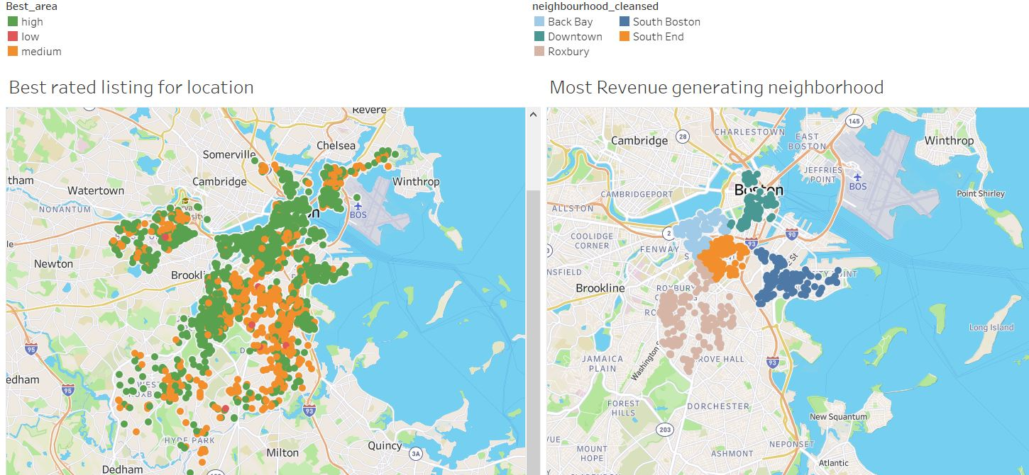
1)Location Demand
The best rated location are the ones raising maximum revenue.
Premium can be charged for location of listing

Slide 5
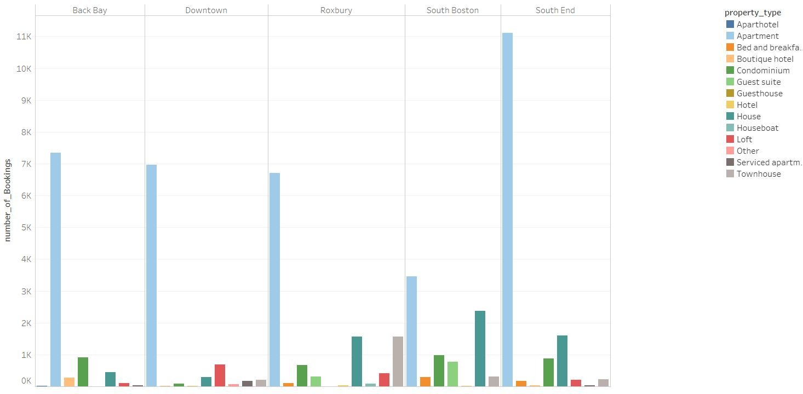
2)Property Type
Apartment is the highest booked property in the top 5 best performing neighbourhood.

Slide 6
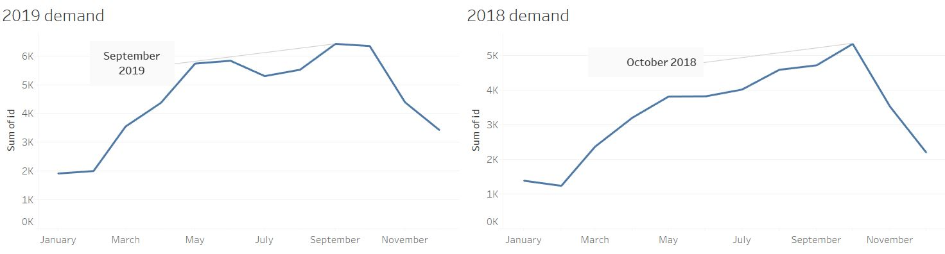
Seasonal demands in bookings
July-October is peak demand season(non intuitive)
November, December, January have the lowest demand

Slide 7
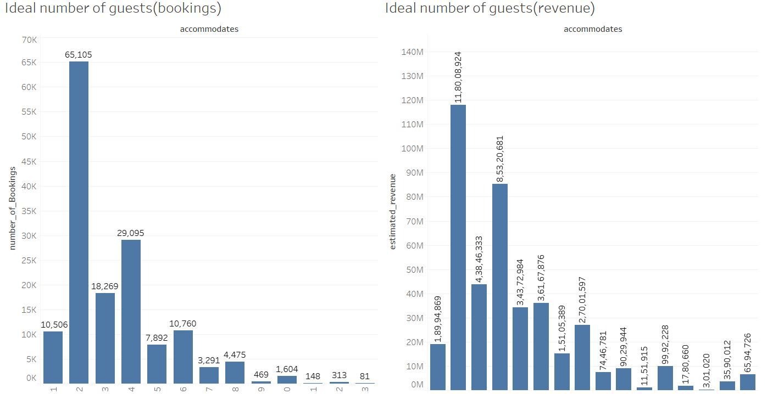
Ideal number of guests
Listings with 2-4 member accommodations have the highest booking and are maximum revenue generating

Slide 8
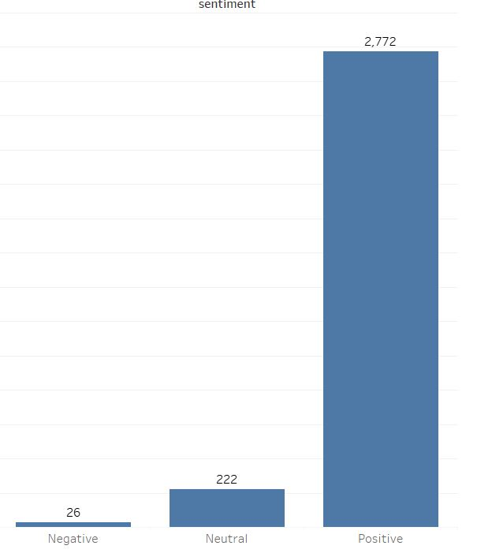
Sentiment analysis
The net sentiment for 99% of the listings was positive/Neutral. Less then 1% of the Listings received a negative sentiment feedback.

Slide 9
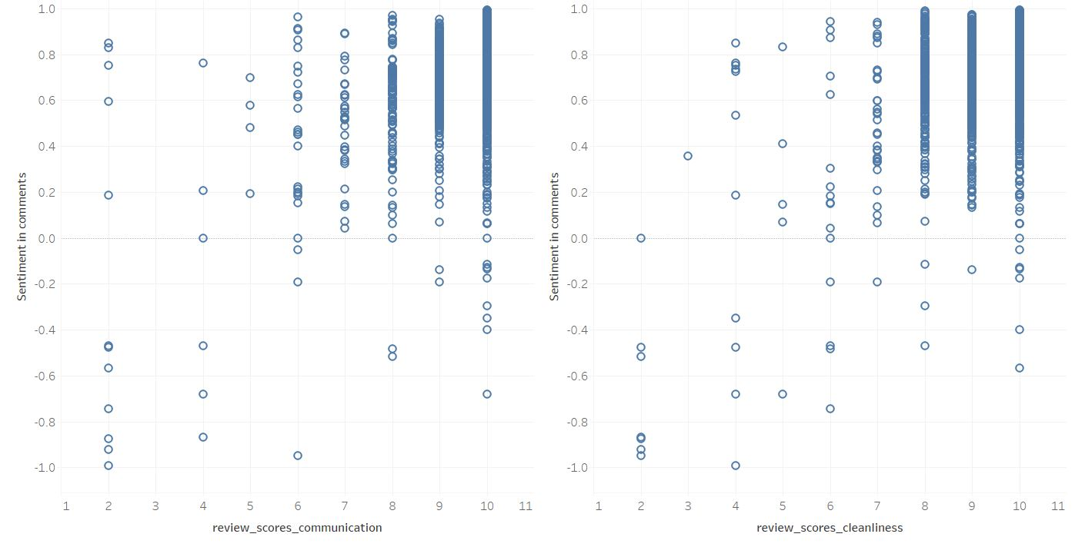
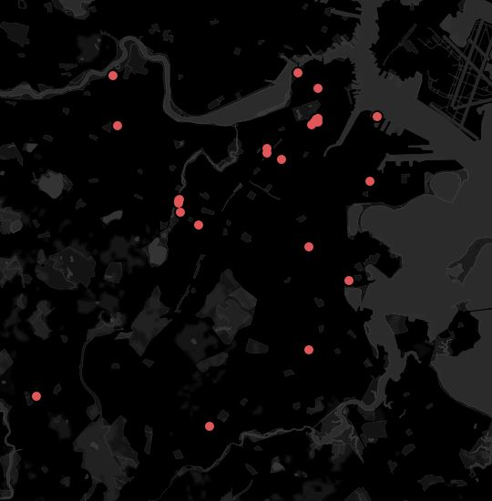
Sentiment relation with Cleanliness, Communication, Location
High correlation between Cleanliness- Sentiment and
Communication -sentiment
Negative sentiment listing spread out across the city

Slide 10
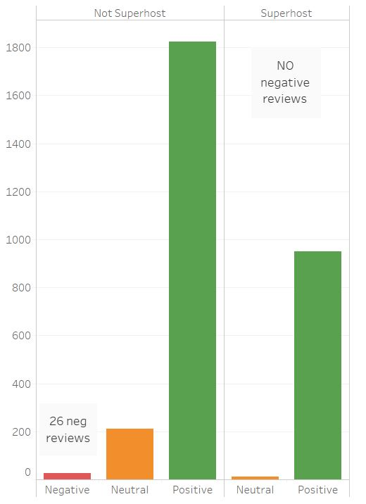
Airbnb already has a defined standard
Superhost requirements:
-Completed at least 10 trips OR completed 3 reservations that total at least 100 nights
-Maintained a 90% response rate or higher
-Maintained a 1% percent cancellation rate
-Maintained a 4.8 overall rating (Cleanliness, communication)

Slide 11
Conclusions
Listings in popular locations
Apartment type properties
June-October bookings
2-4 Accommodating Listings
Listings that are super hosts
Charge premium
Additionally through the seasonal demand analysis we conclude that December- February can be allocated for listing maintenance as the demand is low.

Slide 12
References
Data: http://insideairbnb.com/get-the-data.html

